Slide 1
Unity
Team ID: (A key that uniquely identifies your team)
Members
Name : Vishal M
Name : Satya P
Name : V Shalini
College
College Name : PSG College of Technology
Location : Coimbatore

Slide 2
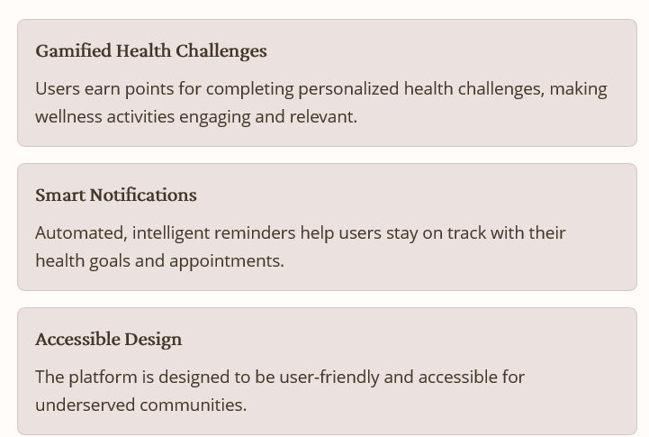
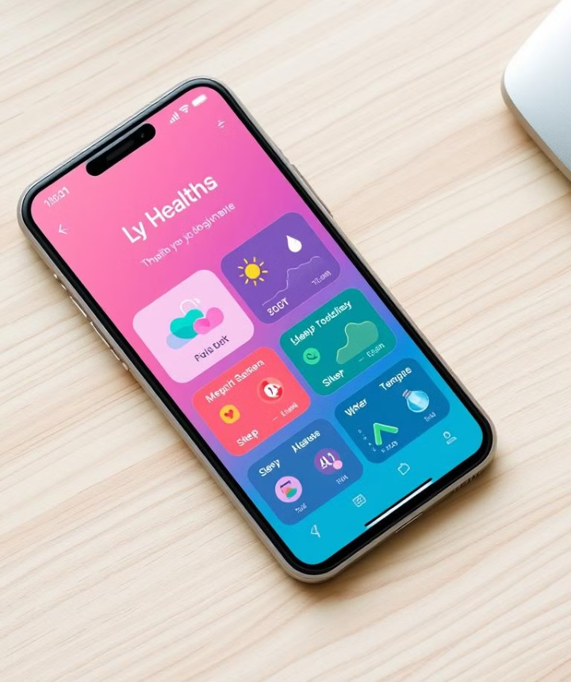
Addressing Health Disparities with Technology

Slide 3
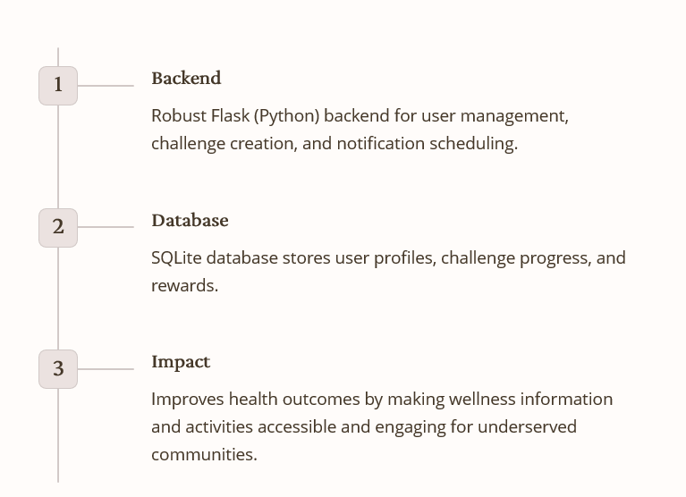
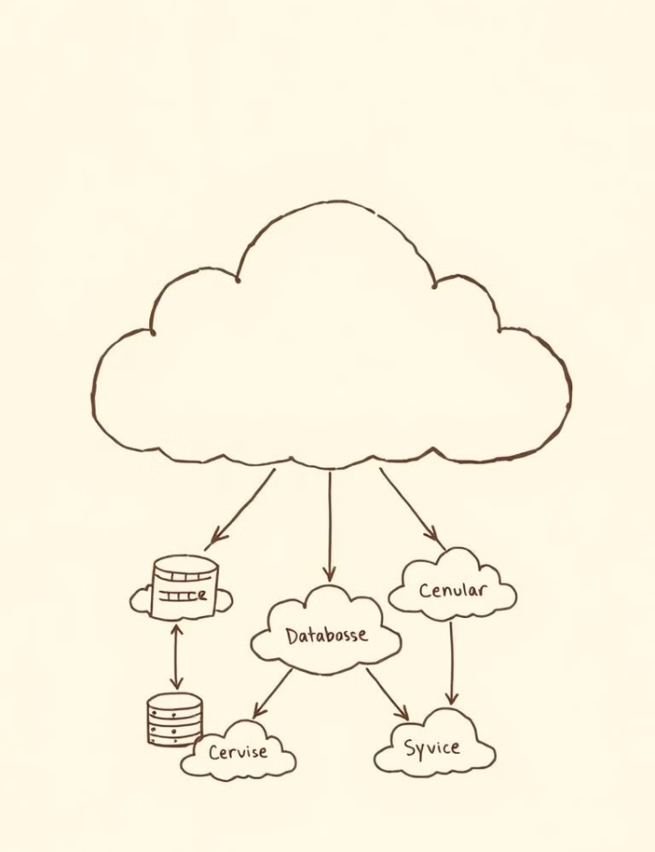
HealthConnect Hubs – Gamified Challenges & Smart Notifications

